Slide 1
Ado.net Entity Framework
ADO.NET entity framework is an ORM (Object Relational Mapping) framework developed by Microsoft to automate database related activities for your application.
The Microsoft ADO.NET Entity Framework enables developers to work with relational data as domain-specific objects, eliminating the need for most of the data access plumbing code that developers usually need to write.
Using the Entity Framework, developers issue queries using LINQ, then retrieve and manipulate data as strongly typed objects.
It is an enhancement to ADO.NET that gives developers an automated mechanism for accessing & storing the data in the database.

Slide 2
Ado.net Entity Framework
Entity framework is useful in three scenarios.
First, if you already have existing database or you want to design your database ahead of other parts of the application.
Second, you want to focus on your domain classes and then create the database from your domain classes.
Third, you want to design your database schema on the visual designer and then create the database and classes.

Slide 3
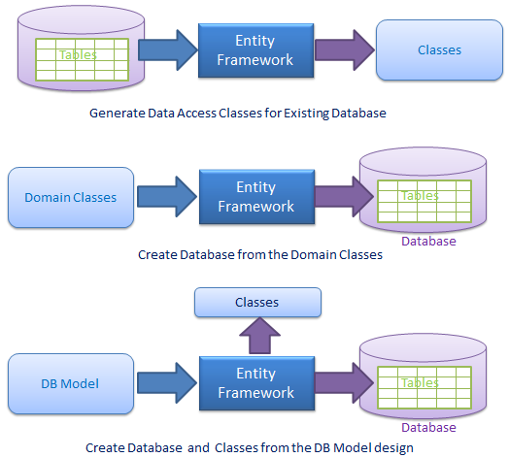
Ado.net Entity Framework

Slide 4
versions of Entity Framework
EF Version | Introduced Features
EF 3.5 | Basic O/RM support with Database First approach.
EF 4.0 | POCO Support, Lazy loading, testability improvements, customizable code generation and the Model First approach.
EF 4.1 | First to available in the NuGet, Simplified DBContext API over ObjectContext, Code First approach.
EF 4.3 | Code First Migrations feature that allows a database created by Code First to be incrementally changed as your Code First model evolves. EF 4.3.1 patch released with bug fixing of EF 4.3.
EF 5.0 | Announced EF as Open Source. Introduced Enum support, table-valued functions, spatial data types, multiple-diagrams per model, coloring of shapes on the design surface and batch import of stored procedures, EF Power Tools and various performance improvements.
EF 6.0 Current release | EF 6.0/6.1 is the latest release of Entity Framework. It includes many new features related to Code First & EF designer like asynchronous query & save, connection Resiliency, dependency resolution etc.

Slide 5
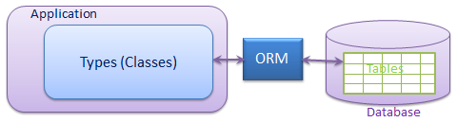
O/RM framework
ORM is a tool for storing data from domain objects to relational database like MS SQL Server in automated way without much programming.
O/RM includes three main parts: Domain class objects, Relational database objects and Mapping information on how domain objects maps to relational database objects (tables, views & stored procedures).
ORM helps us to keep our database design separate from our domain class design. This makes application maintainable and extendable
It also automates standard CRUD operation (Create, Read, Update & Delete) so developer doesn’t need to write it manually.
There are many ORM frameworks for .net in the market like DataObjects.Net, NHibernate, OpenAccess, SubSonic etc . ADO.NET Entity Framework is an open source ORM framework from Microsoft.

Slide 6
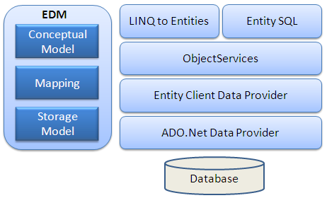
Entity Framework Architecture
EDM (Entity Data Model): EDM consists of three main parts
Conceptual model
Mapping
Storage model.

Slide 7
O/RM framework
Conceptual Model: The conceptual model contains the model classes and their relationships. This will be independent from your database table design.
Storage Model: Storage model is the database design model which includes tables, views, stored procedures, and their relationships and keys.
Mapping: Mapping consists of information about how the conceptual model is mapped to the storage model.
LINQ to Entities: LINQ to Entities is a query language used to write queries against the object model. It returns entities, which are defined in the conceptual model.
Entity SQL: Entity SQL is another query language just like LINQ to Entities.
Object Service:Object service is a main entry point for accessing data from the database and to return it back. Object service is responsible for materialization, which is the process of converting data returned from an entity client data provider (next layer) to an entity object structure.
Entity Client Data Provider:The main responsibility of this layer is to convert L2E or Entity SQL queries into a SQL query which is understood by the underlying database. It communicates with the ADO.Net data provider which in turn sends or retrieves data from the database.
ADO.Net Data Provider:This layer communicates with the database using standard ADO.Net.

Slide 8
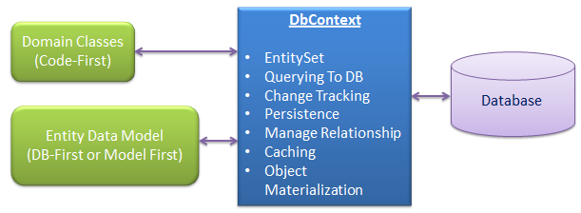
DbContext
DbContext is an important part of Entity Framework. It is a bridge between your domain or entity classes and the database.
DbContext is the primary class that is responsible for interacting with data as object. DbContext is responsible for the following activities:
EntitySet: DbContext contains entity set (DbSet<TEntity>) for all the entities which is mapped to DB tables.
Querying: DbContext converts LINQ-to-Entities queries to SQL query and send it to the database.

Slide 9
DbContext
Change Tracking: It keeps track of changes that occurred in the entities after it has been querying from the database.
Persisting Data: It also performs the Insert, Update and Delete operations to the database, based on what the entity states.
Caching: DbContext does first level caching by default. It stores the entities which have been retrieved during the life time of a context class.
Manage Relationship: DbContext also manages relationship using CSDL, MSL and SSDL in DB-First or Model-First approach or using fluent API in Code-First approach.
Object Materialization: DbContext converts raw table data into entity objects.

Slide 10
POCO Entity (Plain Old CLR Object)
POCO class is the class that doesn't depend on any framework specific base class. It is like any other normal .net class which is why it is called "Plain Old CLR Objects".
These POCO entities (also known as persistence-ignorant objects) support most of the same query, insert, update, and delete behaviors as entity types that are generated by the Entity Data Model.
Entity can have two types of properties, Scalar and Navigation properties.
Scalar properties:
Scalar properties are properties whose actual values are contained in the entity. For example, Student entity has scalar properties like StudentId and StudentName. These correspond with the Student table columns.
Navigation properties:
Navigation properties are pointers to other related entities. The Student has Standard property as a navigation property that will enable the application to navigate from a Student to related Standard entity.

Slide 11
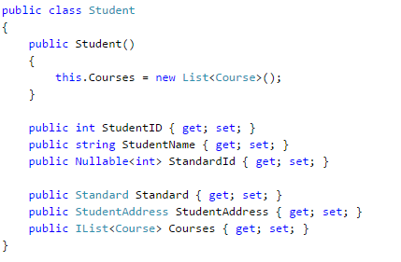
POCO Entity (Plain Old CLR Object)

Slide 12
CODE FIRST

Slide 13
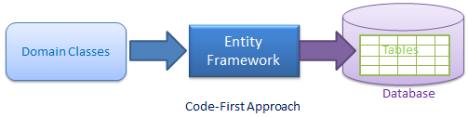
Code-First
Entity Framework introduced Code-First approach from Entity Framework 4.1. Code-First is mainly useful in Domain Driven Design. With the Code-First approach, you can focus on the domain design and start creating classes as per your domain requirement rather than design your database first and then create the classes which match your database design. Code-First APIs will create the database on the fly based on your entity classes and configuration.

Slide 14
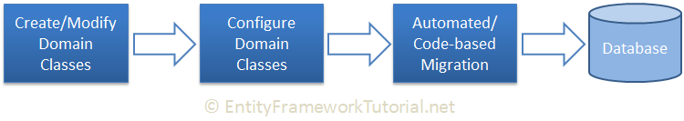
Code-First
Code-First Workflow:
The following figure illustrates the code-first development workflow.
The development workflow in the code-first approach would be: Create or modify domain classes -> configure these domain classes using Fluent-API or data annotation attributes -> Create or update the database schema using automated migration or code-based migration.

Slide 15
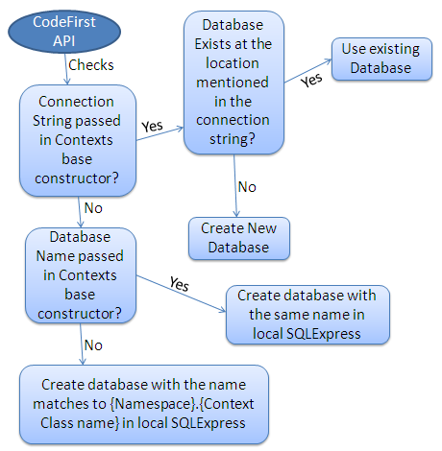
Code-First:Database Initialization

Slide 16
Code-First:Database Initialization
Base constructor of the context class can have the following parameter.
No Parameter
Database Name
Connection String Name
No Parameter
If you do not specify the parameter in the base constructor of the context class then it creates a database in your local SQLEXPRESS server with a name that matches your {Namespace}.{Context class name}. For example, Code First will create a database named SchoolDataLayer.Context for the following context class:
namespace SchoolDataLayer
{
public class Context: DbContext
{ public Context(): base() { }
}
}

Slide 17
Code-First:Database Initialization
Database Name:
You can also specify the database name as a parameter in a base constructor of the context class. If you specify a database name parameter, then Code First creates a database with the name you specified in the base constructor in the local SQLEXPRESS database server. For example, Code First will create a database named MySchoolDB for the following context class.
namespace SchoolDataLayer
{
public class Context: DbContext {
public Context(): base("MySchoolDB") { }
} }

Slide 18
Code-First:Database Initialization
ConnectionString Name:
You can also define connection string in app.config or web.config and specify connection string name starting with "name=" in the base constructor of the context class. Consider the following example where we pass name=SchoolDBConnectionString parameter in the base constructor.
namespace SchoolDataLayer {
public class Context: DbContext {
public SchoolDBContext() : base("name=SchoolDBConnectionString") { }
} }
<connectionStrings> <add name="SchoolDBConnectionString" connectionString="Data Source=.;Initial Catalog=SchoolDB-ByConnectionString;Integrated Security=true" providerName="System.Data.SqlClient"/>
</connectionStrings> </configuration>

Slide 19
Code First Conventions
Convention is a set of default rules to automatically configure a conceptual model based on domain class definitions when working with Code-First. Code-First conventions are defined in System.Data.Entity.ModelConfiguration.Conventions namespace.
Primary Key Convention
Code-First automatically creates a Primary Key in each table. The default convention for primary key is that Code-First would create a primary key for a property if the property name is Id or <class name>Id (NOT case sensitive). The data type of a primary key property can be anything, but if the type of the primary key property is numeric or GUID, it will be configured as an identity column.
Relationship Convention:
Code First infer the relationship between the two entities using navigation property. This navigation property can be simple reference type or collection type.

Slide 20
Code First Conventions
Foreign key Convention
Code First automatically inserts a foreign key when it encounters a navigation property.

Slide 21
C# DataType | Related DB Column DataType | PK Column DataType & Length
int | int | int, Identity column increment by 1
string | nvarchar(Max) | nvarchar(128)
decimal | decimal(18,2) | decimal(18,2)
float | real | real
byte[] | varbinary(Max) | varbinary(128)
datetime | datetime | datetime
bool | bit | bit
byte | tinyint | tinyint
short | smallint | smallint
long | bigint | bigint
double | float | float
char | No mapping | No mapping
sbyte | No mapping (throws exception) | No mapping
object | No mapping | No mapping

Slide 22
Configure Domain Classes in Code-First
Code-First builds conceptual model from your domain classes using default conventions.
We can an override these conventions by configuring your domain classes to provide EF with the information it needs. There are two ways to configure your domain classes.
DataAnnotations
Fluent API
DataAnnotation:
DataAnnotation is a simple attribute based configuration, which you can apply to your domain classes and its properties. You can find most of the attributes in the System.ComponentModel.DataAnnotations namespace.

Slide 23
DataAnnotations in Code-First
EF Code-First provides a set of DataAnnotation attributes, which you can apply to your domain classes and properties. DataAnnotation attributes override default Code-First conventions. System.ComponentModel.DataAnnotations includes attributes that impacts on nullability or size of the column. System.ComponentModel.DataAnnotations.Schema namespace includes attributes that impacts the schema of the database.

Slide 24
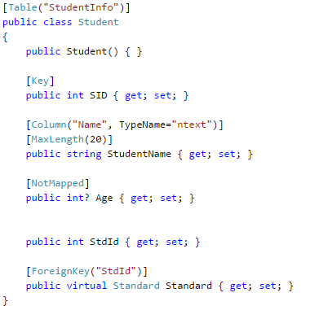
Configure Domain Classes in Code-First

Slide 25
System.ComponentModel.DataAnnotations
Attribute | Description
Key | Mark property as EntityKey which will be mapped to PK of the related table.
Timestamp | Mark the property as a non-nullable timestamp column in the database.
Required | The Required annotation will force EF (and MVC) to ensure that property has data in it.
MinLength | MinLength annotation validates property whether it has minimum length of array or string.
MaxLength | MaxLength annotation is the maximum length of property which in turn sets the maximum length of a column in the database
StringLength | Specifies the minimum and maximum length of characters that are allowed in a data field.

Slide 26
System.ComponentModel.DataAnnotations.Schema
Attribute | Description
Table | Specify name of the DB table which will be mapped with the class
Column | Specify column name and datatype which will be mapped with the property
Index | Create an Index for specified column. (EF 6.1 onwards only)
ForeignKey | Specify Foreign key property for Navigation property
NotMapped | Specify that property will not be mapped with database

Slide 27
Fluent API Configurations in EF 6
Entity Framework Fluent API is used to configure domain classes to override conventions. EF Fluent API is based on a Fluent API design pattern where the result is formulated by method chaining.
In Entity Framework 6, the DbModelBuilder class acts as a Fluent API using which we can configure many different things. It provides more options of configurations than Data Annotation attributes.
To write Fluent API configurations, override the OnModelCreating() method of DbContext in a context class.
public class SchoolContext: DbContext
{
public DbSet<Student> Students { get; set; }
protected override void OnModelCreating(DbModelBuilder modelBuilder) { //Write Fluent API configurations here
} }
Note:You can use Data Annotation attributes and Fluent API at the same time. Entity Framework gives precedence to Fluent API over Data Annotations attributes.

Slide 28
Fluent API Configurations in EF 6
Fluent API configures the following aspect of a model in Entity Framework 6:
Model-wide Configuration: Configures the default Schema, entities to be excluded in mapping, etc.
Entity Configuration: Configures entity to table and relationship mappings e.g. PrimaryKey, Index, table name, one-to-one, one-to-many, many-to-many etc.
Property Configuration: Configures property to column mappings e.g. column name, nullability, Foreignkey, data type, concurrency column, etc.

Slide 29
Fluent API Configurations in EF 6
Configurations | Fluent API Methods | Usage
Model-wide Configurations | HasDefaultSchema() | Specifies the default database schema.
 | ComplexType() | Configures the class as complex type.
Entity Configurations | HasIndex() | Configures the index property for the entity type.
 | HasKey() | Configures the primary key property for the entity type.
 | HasMany() | Configures the Many relationship for one-to-many or many-to-many relationships.
 | HasOptional() | Configures an optional relationship which will create a nullable foreign key in the database.
 | HasRequired() | Configures the required relationship which will create a non-nullable foreign key column in the database.
 | Ignore() | Configures that the class or property should not be mapped to a table or column.
 | Map() | Allows advanced configuration related to how the entity is mapped to the database schema.

Slide 30
Fluent API Configurations in EF 6
Property Configurations | HasColumnAnnotation() | Sets an annotation in the model for the database column used to store the property.
 | IsRequired() | Configures the property to be required on SaveChanges().
 | IsConcurrencyToken() | Configures the property to be used as an optimistic concurrency token.
 | IsOptional() | Configures the property to be optional which will create a nullable column in the database.
 | HasParameterName() | Configures the name of the parameter used in the stored procedure for the property.
 | HasDatabaseGeneratedOption() | Configures how the value will be generated for the corresponding column in the database e.g. computed, identity or none.
 | HasColumnOrder() | Configures the order of the database column used to store the property.
 | HasColumnType() | Configures the data type of the corresponding column of a property in the database.
 | HasColumnName() | Configures the corresponding column name of a property in the database.
 | IsConcurrencyToken() | Configures the property to be used as an optimistic concurrency token.

Slide 31
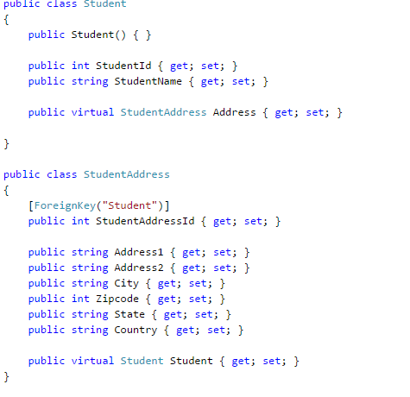
Configure One-to-Zero-or-One Relationship
we will configure One-to-Zero-or-One relationship between two entities, e.g. Entity1 can be associated with zero or only one instance of Entity2.

Slide 32
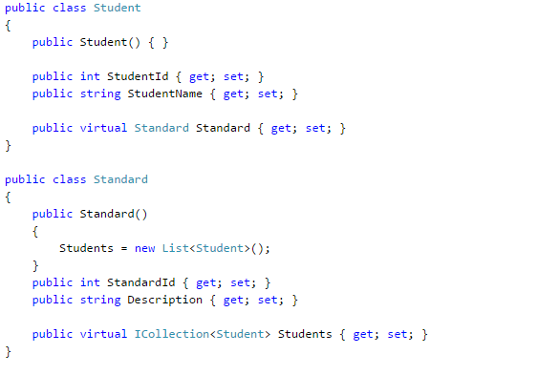
Configure One-to-Many Relationship

Slide 33
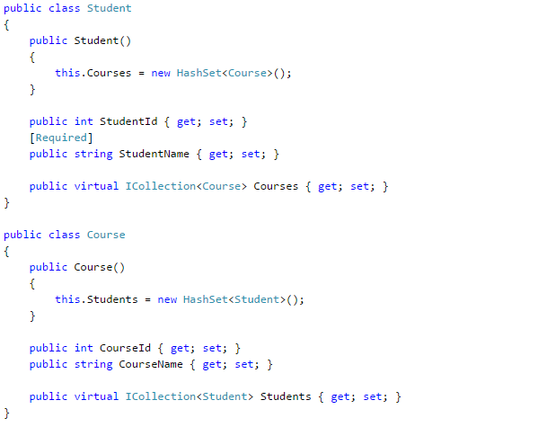
Configure Many-to-Many relationship

Slide 34
Migration in Code-First
Entity framework introduced a migration tool that automatically updates the database schema, when your model changes without losing any existing data or other database objects. It uses a new database initializer called MigrateDatabaseToLatestVersion.
There are two kinds of Migration:
Automated Migration
Code based Migration

Slide 35
Automated Migration in Entity Framework 6
Entity framework introduced automated migration so that you don't have to process database migration manually for each change you make in your domain classes.
The automated migrations can be implemented by executing enable-migrations command in the Package Manager Console. Open the package manager console from Tools → Library Package Manager → Package Manager Console and then run enable-migrations –EnableAutomaticMigration:$true command (make sure that the default project is the project where your context class is).

Slide 36
Automated Migration in Entity Framework 6
Step 1 - Open Package Manger Console from Tools ? NuGet Package Manger ? Package Manger Console.
Step 2 - To enable automated migration run the following command in Package Manager Console.
PM> enable-migrations -EnableAutomaticMigrations:$true
Step 3 - Once the command runs successfully, it creates an internal sealed Configuration class in the Migration folder of your project as shown in the following code.
Step 4 - Set the database initializer in the context class with the new DB initialization strategy MigrateDatabaseToLatestVersion.
public MyContext() : base("MyContextDB") {
Database.SetInitializer(new MigrateDatabaseToLatestVersion<MyContext,
EFCodeFirstDemo.Migrations.Configuration>("MyContextDB"));
}
Step 5 - You have set up automated migration. When you execute your application, then it will automatically take care of migration, when you change the model.
Step 6 - To handle the property migration you need to set AutomaticMigrationDataLossAllowed = true in the configuration class constructor.
public Configuration() {
AutomaticMigrationsEnabled = true;
AutomaticMigrationDataLossAllowed = true;
ContextKey = "EFCodeFirstDemo.MyContext";
}

Slide 37

Code-Based Migration in Entity Framework 6
The code-based migration provides more control on the migration and allows you to configure additional things such as setting default value of a column, configure computed column etc.
In order to use code-based migration, you need to execute the following commands in Package Manager Console in Visual Studio:
Enable-Migrations: Enables the migration in your project by creating Configuration class.
Add-Migration: Creates a new migration class as per specified name with Up() and Down() methods.
Update-Database: Executes the last migration file created by Add-Migration command and applies changes to the database schema.
To use code-based migrations, first execute the enable-migrations command in the Package Manager Console. Open the package manager console from Tools → Library Package Manager → Package Manager Console and then run enable-migrations command (make sure that the default project is the project where your context class is).
The Enable-Migrations command will create Configuration class derived from DbMigrationsConfiguration with AutomaticMigrationsEnabled = false.

Slide 38
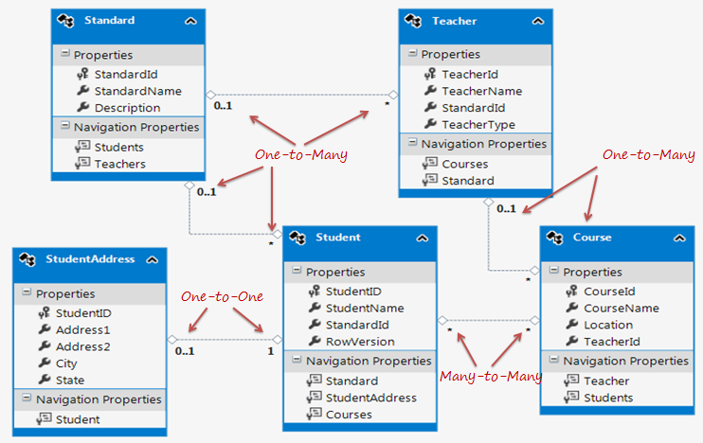
Entity Relationships
Entity framework supports three types of relationships, same as database: 1) One to One 2) One to Many, and 3) Many to Many.

Slide 39
Database Initialization Strategies in EF 6 Code-First
You already created a database after running your Code-First application the first time, but what about the second time onwards? Will it create a new database every time you run the application? What about the production environment? How do you alter the database when you change your domain model? To handle these scenarios, you have to use one of the database initialization strategies.
There are four different database initialization strategies:
CreateDatabaseIfNotExists: This is the default initializer. As the name suggests, it will create the database if none exists as per the configuration. However, if you change the model class and then run the application with this initializer, then it will throw an exception.
DropCreateDatabaseIfModelChanges: This initializer drops an existing database and creates a new database, if your model classes (entity classes) have been changed. So, you don't have to worry about maintaining your database schema, when your model classes change.

Slide 40
Database Initialization Strategies in EF 6 Code-First
DropCreateDatabaseAlways: As the name suggests, this initializer drops an existing database every time you run the application, irrespective of whether your model classes have changed or not. This will be useful when you want a fresh database every time you run the application, for example when you are developing the application.
Custom DB Initializer: You can also create your own custom initializer, if the above do not satisfy your requirements or you want to do some other process that initializes the database using the above initializer.

Slide 41
Database Initialization Strategies in EF 6 Code-First
public class SchoolDBContext: DbContext { public SchoolDBContext(): base("SchoolDBConnectionString") { Database.SetInitializer<SchoolDBContext>(new CreateDatabaseIfNotExists<SchoolDBContext>()); //Database.SetInitializer<SchoolDBContext>(new DropCreateDatabaseIfModelChanges<SchoolDBContext>()); //Database.SetInitializer<SchoolDBContext>(new DropCreateDatabaseAlways<SchoolDBContext>()); //Database.SetInitializer<SchoolDBContext>(new SchoolDBInitializer()); } public DbSet<Student> Students { get; set; } public DbSet<Standard> Standards { get; set; }

Slide 42
Database Initialization Strategies in EF 6 Code-First
You can also create your custom DB initializer, by inheriting one of the initializers, as shown below:
public class SchoolDBInitializer : CreateDatabaseIfNotExists<SchoolDBContext>
{
protected override void Seed(SchoolDBContext context)
{
base.Seed(context);
}
}

Slide 43
Transaction in Entity Framework
Entity Framework internally maintains transactions when the SaveChanges() method is called. It means the Entity Framework maintains a transaction for the multiple entity insert, update and delete in a single SaveChanges() method.
Earlier the System.Transactions namespace was used to handle transactions in the Entity Framework using TransactionScope and the Entity Framework uses this transaction to save the changes in the database.
using (TransactionScope scope = new TransactionScope())
{
//Code Here
}

Slide 44
Transaction in Entity Framework
Entity Framework 6.0 introduced two new APIs to maintain the transaction.
DbContext.Database.BeginTransaction: It allows us to begin a transaction. It allows us to combine several operations to be combined within the same transaction and hence all the transactions are either committed or rolled back. This method allows us to specify the isolation level for the transaction.

Slide 45
Transaction in Entity Framework
DbContext.Database.BeginTransaction This method returns a DbContextTransaction object. The BeginTransaction method has two overloads, one has no argument and the other accepts an explicit Isolation Level. A DbContextTransaction object provides Commit() and Rollback() methods to do commit and rollback on the underlying store transaction.

Slide 46
Transaction in Entity Framework
using (EntitiesContext context = new EntitiesContext())
{
using (var transaction = context.Database.BeginTransaction())
{
try
{
EmployeeMaster employee = new EmployeeMaster();
employee.Code = "A0001";
employee.Name = "Jignesh Trivedi";
employee.DepartmentId = 1;
context.Employees.Add(employee);
context.SaveChanges();
DepartmentMaster dept = new DepartmentMaster();
dept.Code = "DEP0001";
dept.Name = "Department 1";
context.Departments.Add(dept);
context.SaveChanges();
transaction.Commit();
}
catch (Exception ex)
{
transaction.Rollback();
}
}
}

